Slide 1


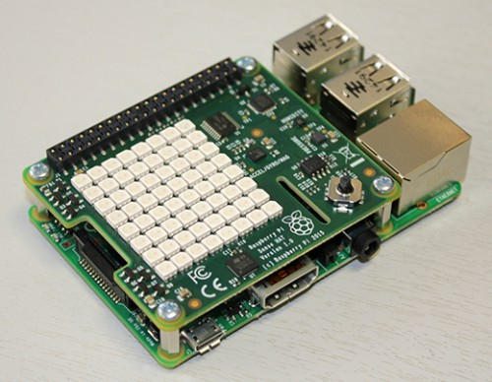

EG206 Semestral Project IV
Launch
Introduction to Linux commands

Slide 2

Outline
Linux commands Handson

Slide 3
Linux OS
What is Linux ???

Slide 4

Linux
Linux is an operating system
Hi I am Tux penguin, the mascot of Linux!
Linux is a kernel, which put together with software from GNU and BSD and lots of other places, makes up an operating system
Linux is comes from a large family of operating systems descended from Unix.
The flavour of Linux, also known as a Linux distribution.
For Raspberry Pi it has its own custom version of Debian GNU/Linux
Raspbian (a portmanteau of Raspberry+Debian)

Slide 5
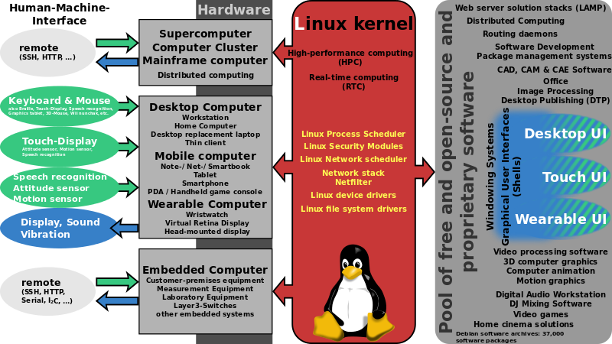
Shmuel Csaba Otto Traian CC BY-SA 3.0, via Wikimedia Commons

Slide 6
Linux OS
Hand on using Common Linux commands

Slide 7
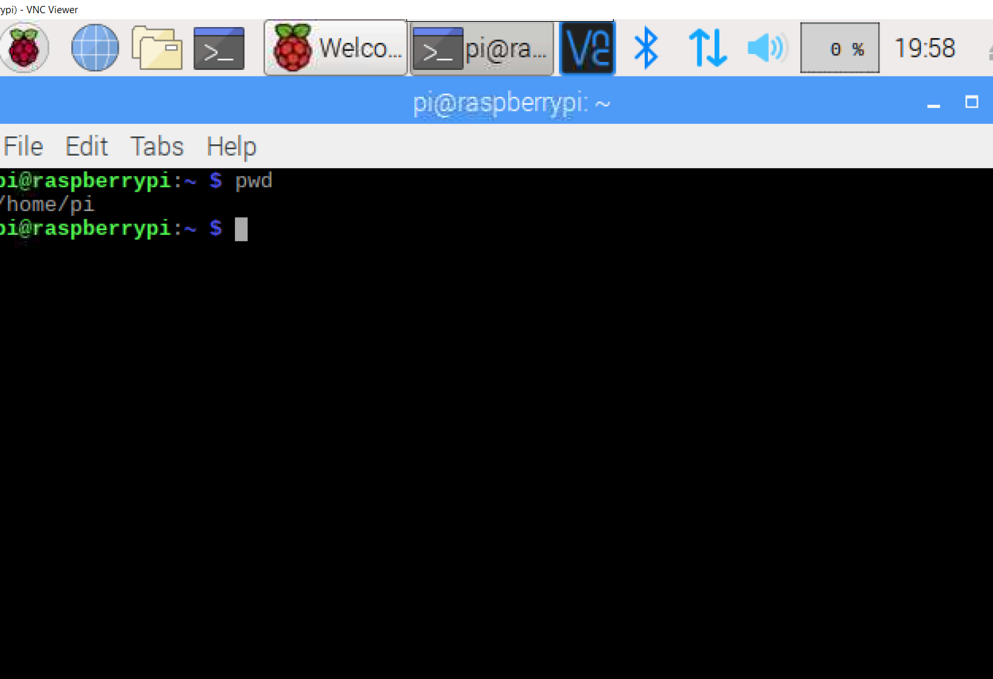
pwd - print working directory
To know which directory you are in, you can use the “pwd” command. It gives us the absolute path, which means the path that starts from the root. The root is the base of the Linux file system. It is denoted by a forward slash( / )For more on ways to use the cat command

Slide 8
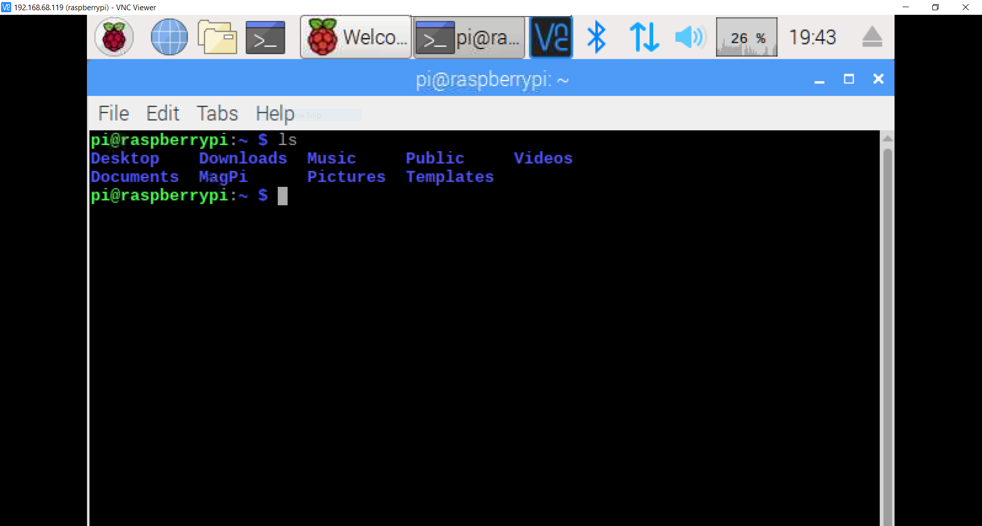
ls - List
Lists the folder and file names in the current working directory. You can narrow the list down to files matching a specific name by passing the name as a parameter.
This comes with a variety of flags; a few key ones are -l to list the long format that displays the file permissions, and -a to list all files including hidden files.

Slide 9
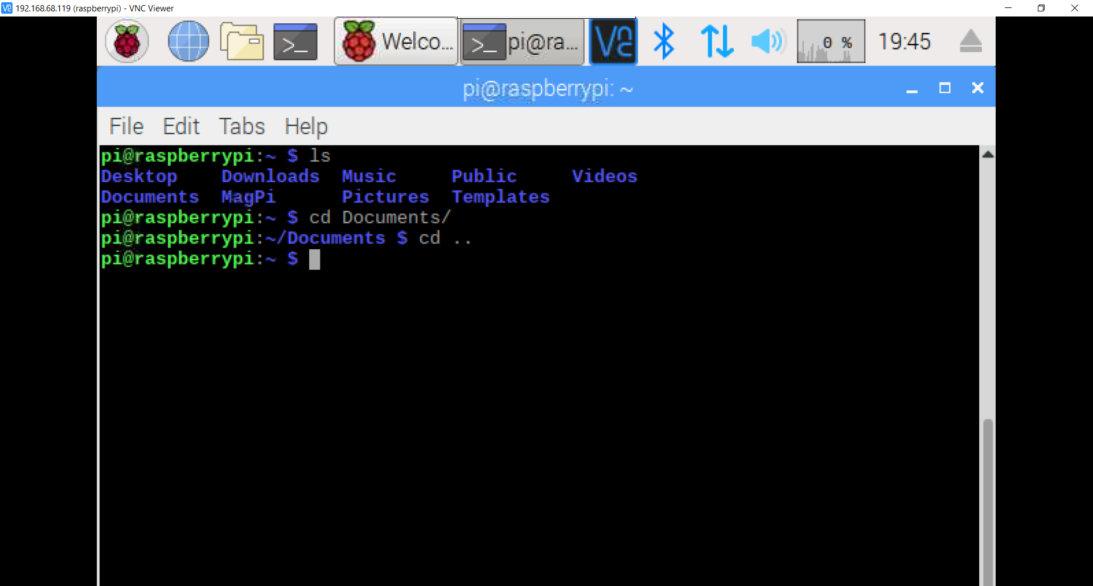
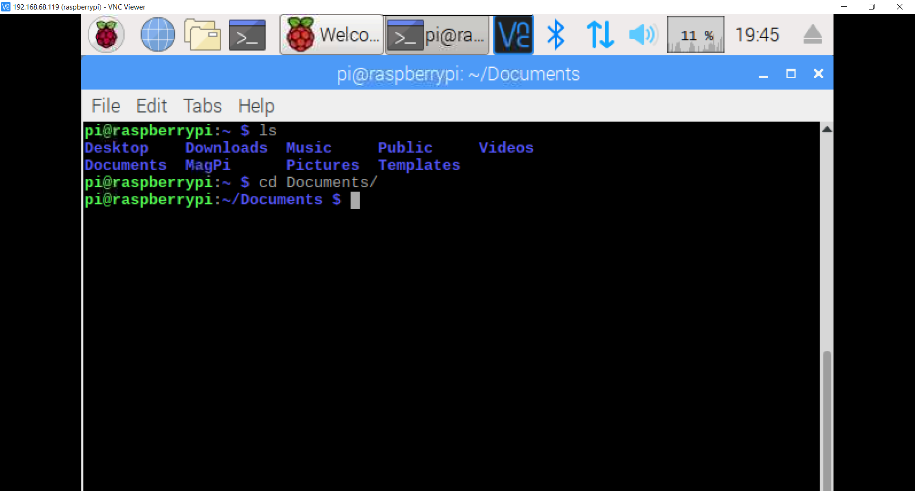
cd - Change Directory
Change Directory to the path specified, for example cd EGR206. There are a few really helpful arguments to aid this:
. refers to the current directory ./projects
.. can be used to move up one folder, use cd .., and can be combined to move up multiple levels ../../my_folder
/is the root of your system to reach core folders, such as system, users, etc
~ is the home directory, usually the path /users/username. Move back to folders referenced relative to this path by including it at the start of your path, for example ~/projects .
If you need to access your shell configuration, you can easily find this with ~/.bashrc or ~/.zshrc — then add all sorts of beneficial aliases, configurations, commands and paths.

Slide 10
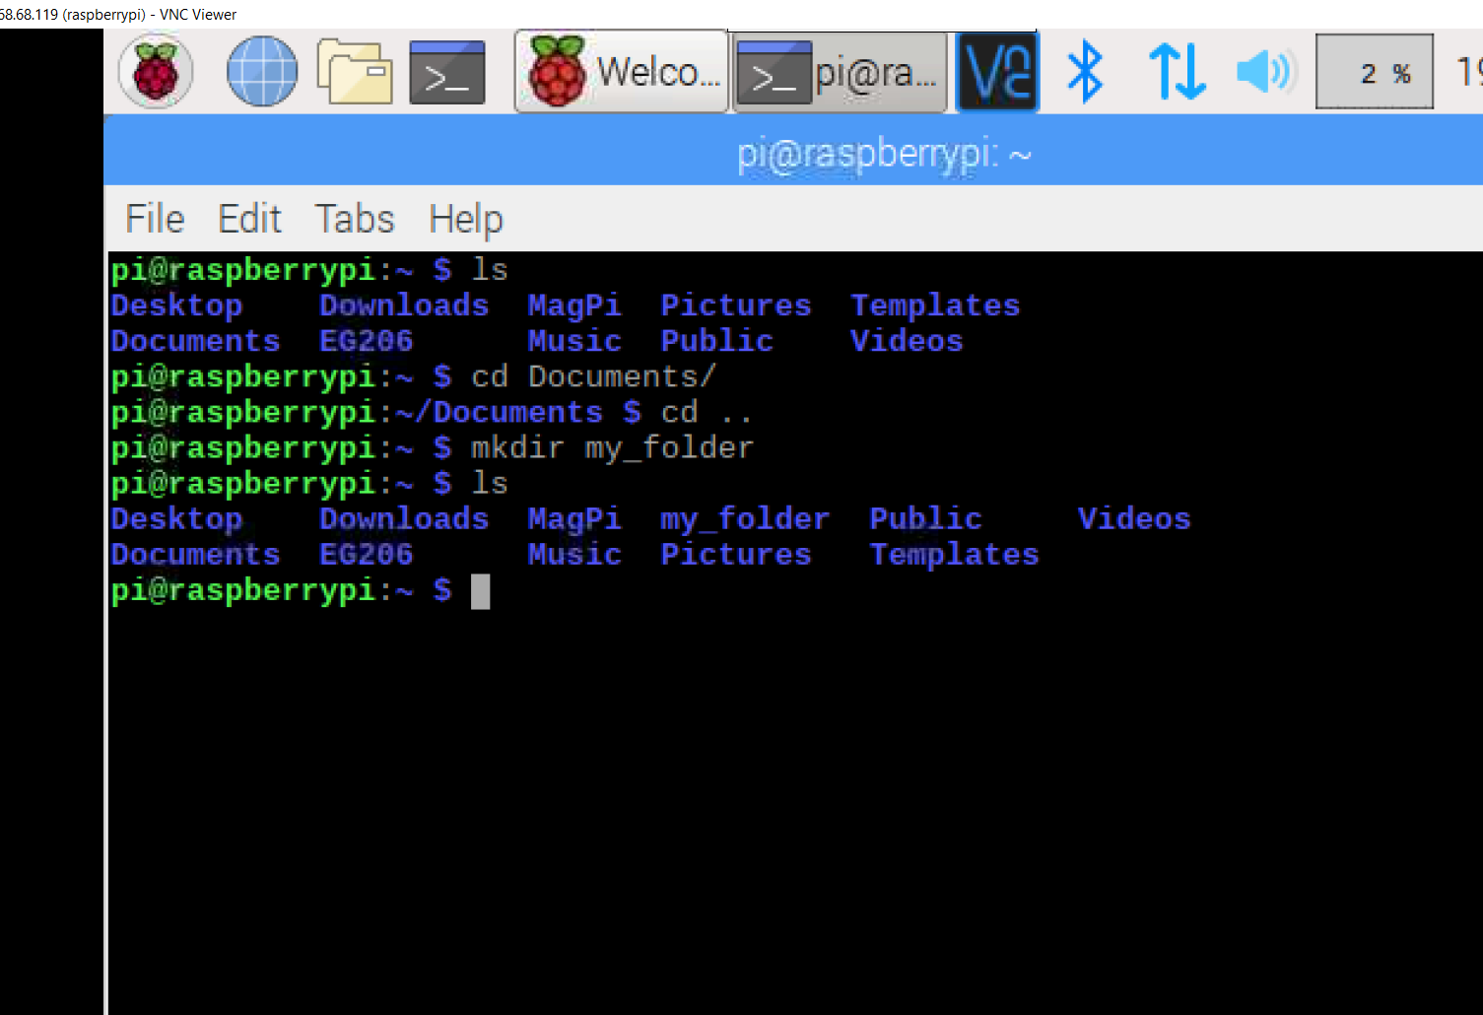
mkdir- Make directories
Make directories with this command mkdir my_folder . Not only can it make the folder specified, but also its parents if they do not exist already using the -p option. The command mkdir -p first_folder/next_folder/my_folder would also create the first and next folder. There is an option to set the mode, or permissions, via the -m flag, and these can be changed later with the chmod command (see below for more on mode and permissions).

Slide 11
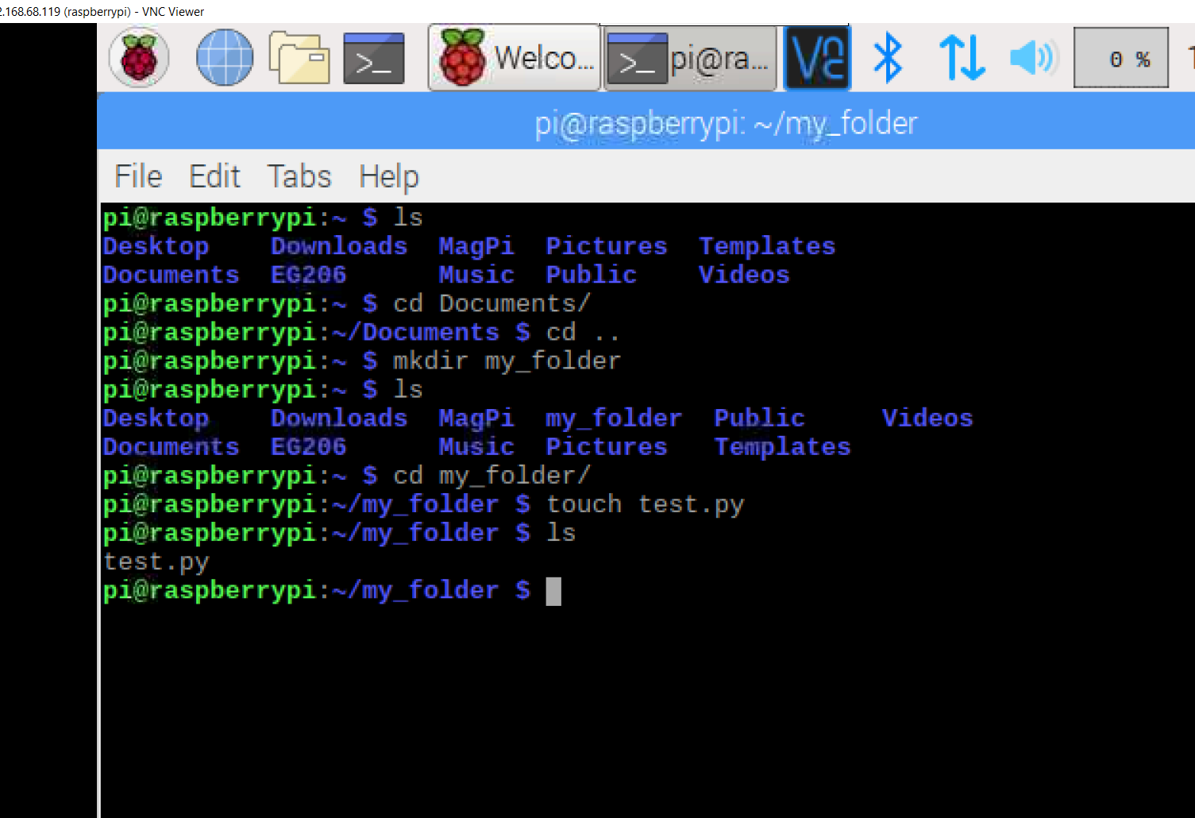
touch - Touches
Touches the file to update the access and or modification date of a file or directory without opening, saving or closing the file. But one of the most common uses is to create an empty file touch my_file.

Slide 12
cat - Concatenate
Concatenate and print files to stdout cat my_file. You can pass one or more file names to this command, and even number the lines using the -n to number the lines. A close cousin of this is vi to launch a terminal-based text editor.
For more on ways to use the cat command - 13 Basic Cat Command Examples in Linux

Slide 13
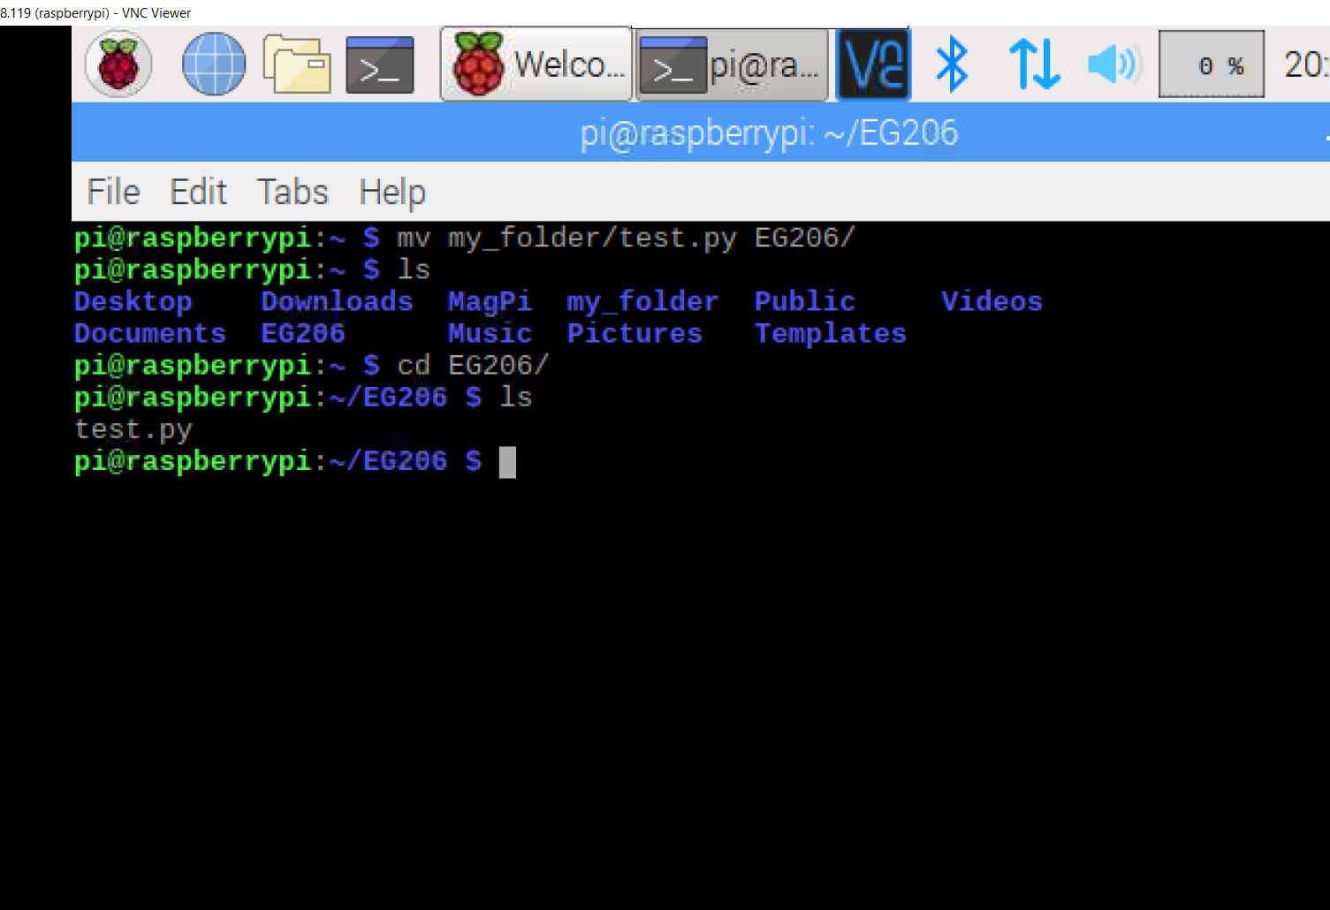
mv - Moves
Moves files and folders. The first argument is the file you want to move, and the second is the location to move it to. Use the flags -f to force move them and -i to prompt confirmation before overwriting files.

Slide 14
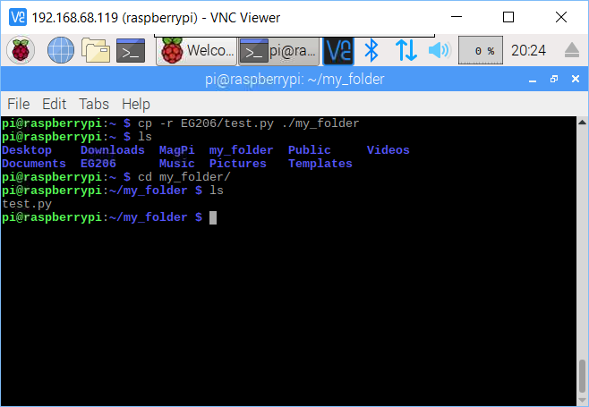
cp - Copies
Copies files and folders cp my_file ./projects . The flag -r recursively copies subfolders and files.

Slide 15
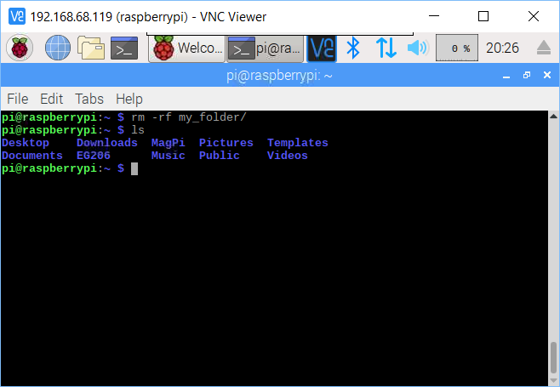
rm - Removes
Removes files and folders rm my_folder . Using -r will again recursively delete subfolders, -f force deletes, and -rf for a recursive force delete. If you want to remove all folders and files in the current directory the command is rm -rf ./* , if you leave out the dot then it would reference the root directory!
Want to see what happens if you force a computer to run rm -rf /? Tip: don’t try this on yours, instead watch this video: - What happens when you sudo rm -rf / your machine? — YouTube

Slide 16
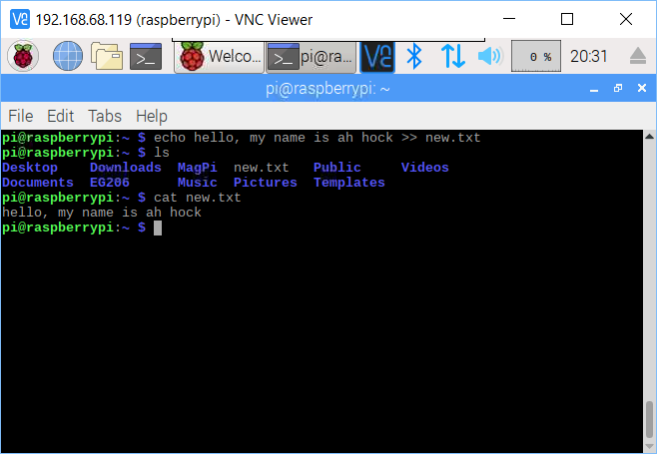
echo - Change mode
The "echo" command helps us move some data, usually text into a file. For example, if you want to create a new text file or add to an already made text file, you just need to type in, “echo hello, my name is ah hock >> new.txt”. You do not need to separate the spaces by using the backward slash here, because we put in two triangular brackets when we finish what we need to write.

Slide 17
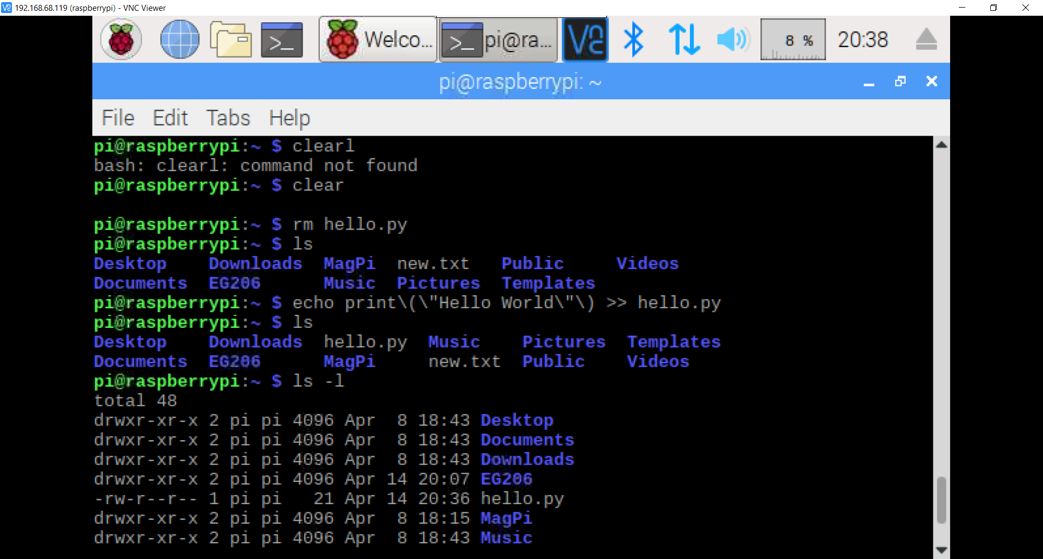
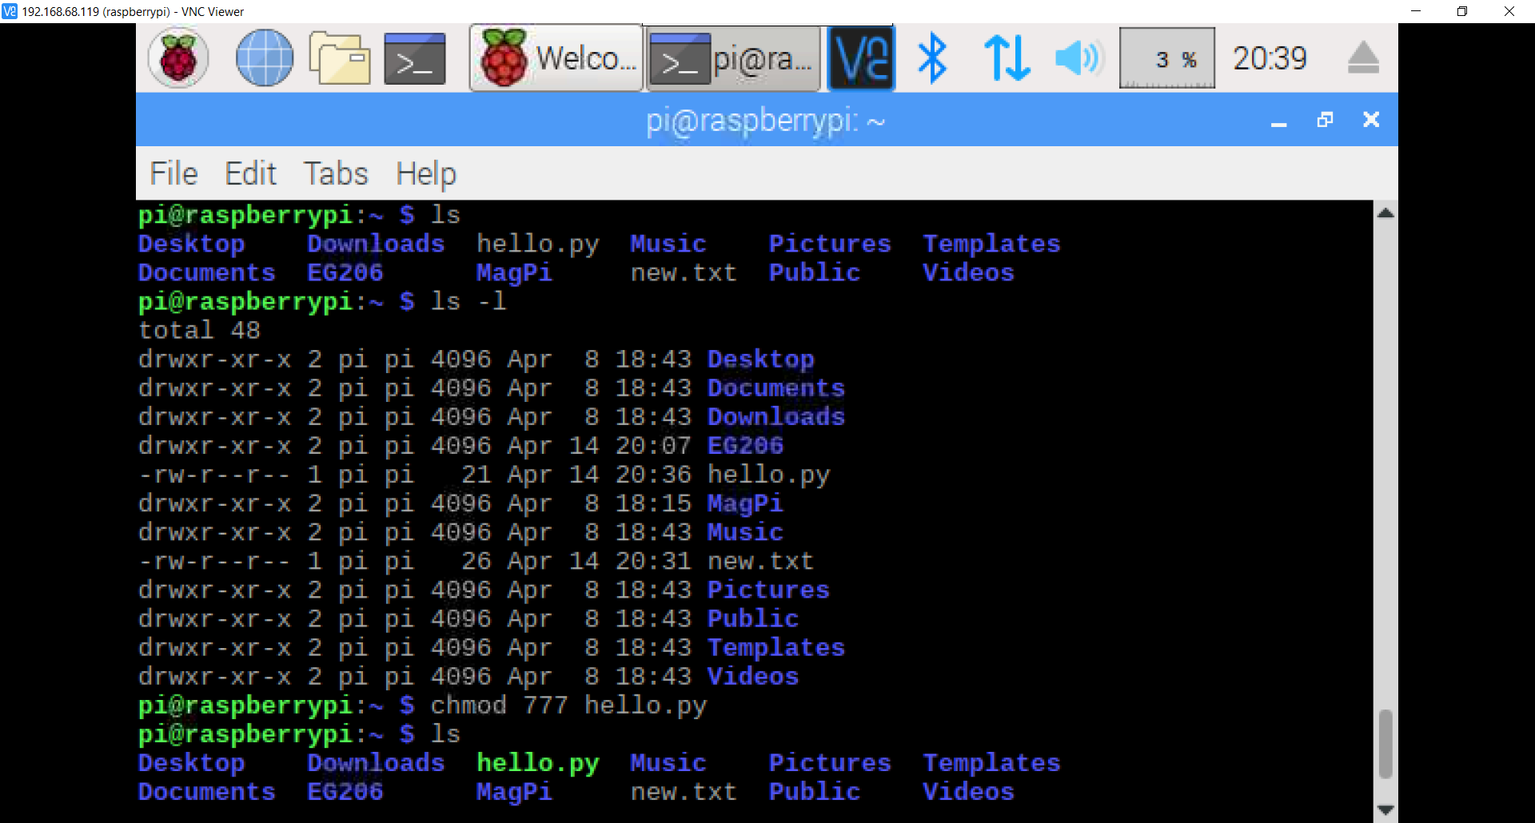
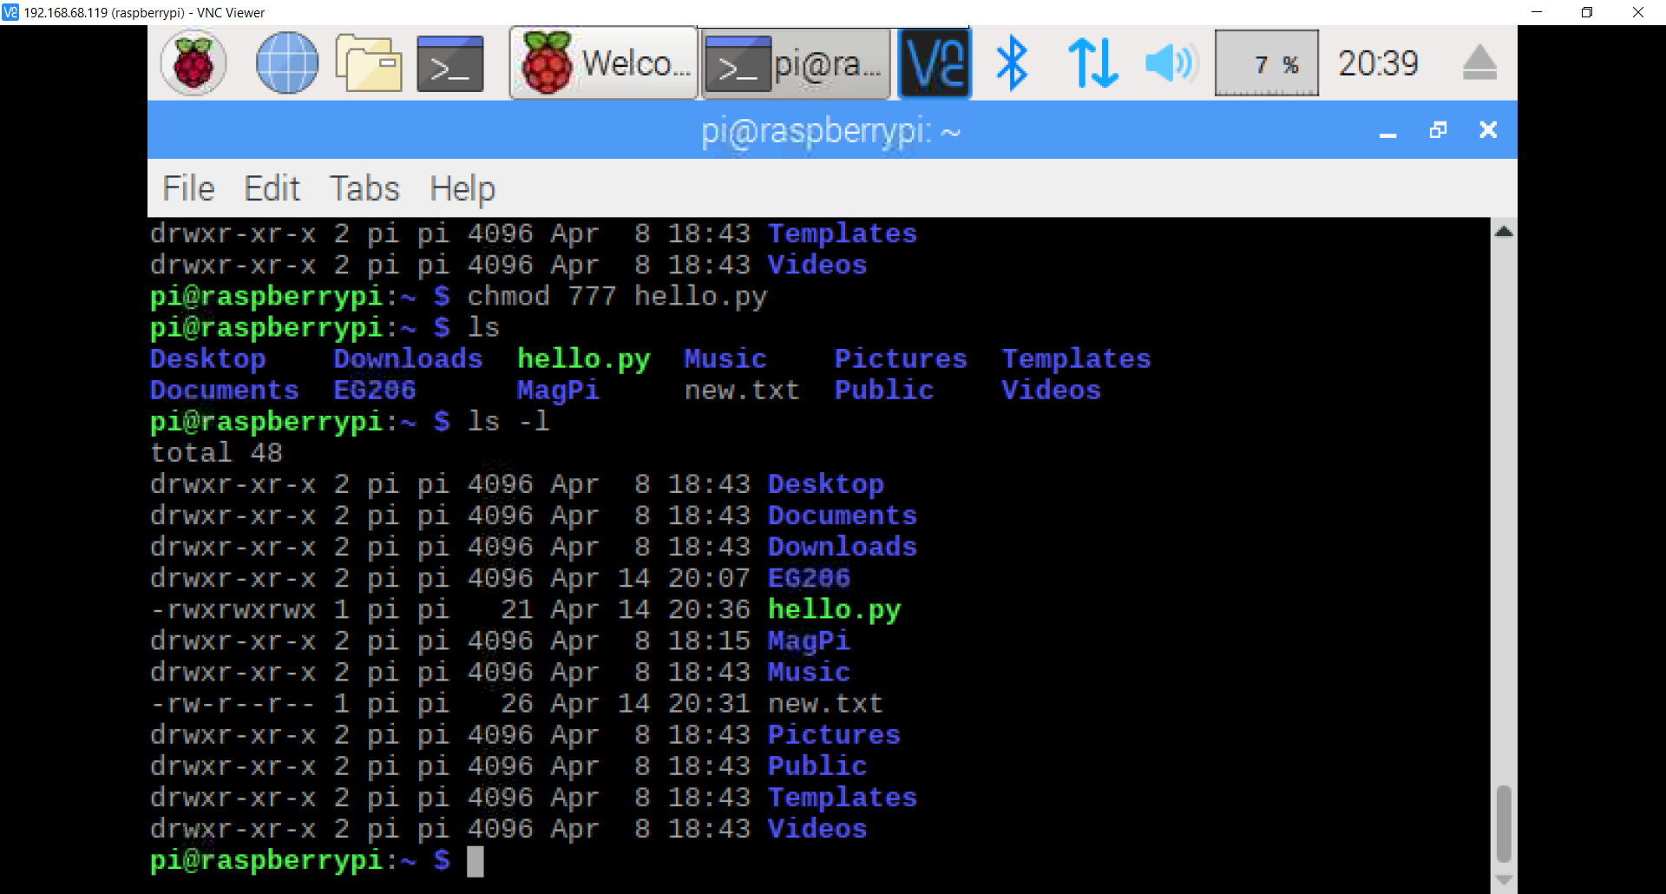
chmod - Change mode
Change mode so you can set permissions for read, write and execute for the user, members of your group and others. This uses binary values as an argument to set these. There are many common chmod permissions, a few key ones are:
777 — anyone can read, write and execute chmod 777 my_file
755 — for files that should be readable and executable by others, but only changeable by the issuing user
700 — only the user can do anything to the file
For a more lengthy and detailed explanations of chmod see - ComputerHope: Linux Chmod Command

Slide 18
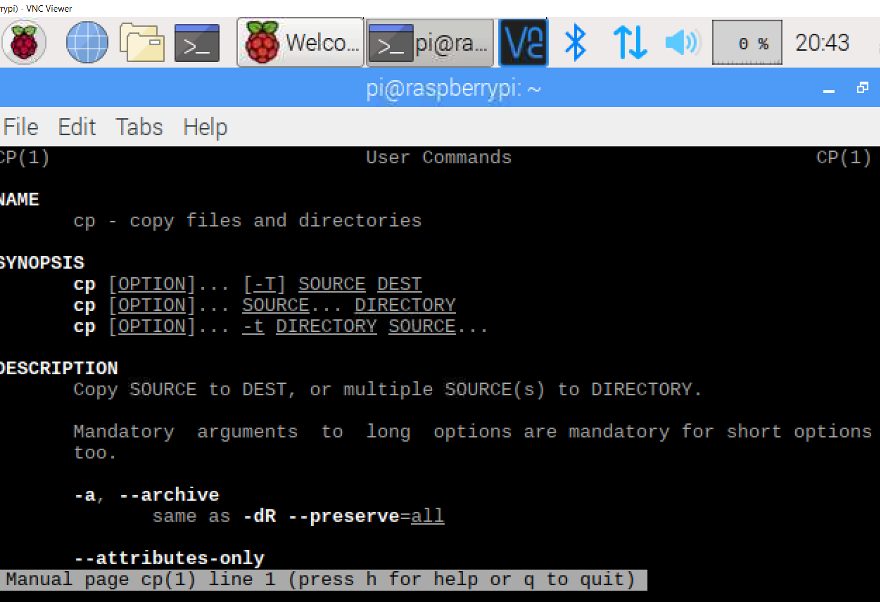
man - Manuals
Manuals for a command can be shown with this instruction. Below is some of the output from running man ls, it also displays all the options available for running the command.
LS(1) BSD General Commands Manual LS(1)
NAME ls -- list directory contents
SYNOPSIS ls [-ABCFGHLOPRSTUW@abcdefghiklmnopqrstuwx1] [file ...]
DESCRIPTION For each operand that names a file of a type other than directory, ls displays its name as well as any requested, associated information. For each operand that names a file of type directory, ls displays the names of files contained within that directory, as well as any requested, associated information.

